Slide 1
“This Excel dashboard transforms raw product sales data into meaningful insights through dynamic slicers, charts, and KPIs. Using Excel formulas, pivot tables, and visuals, it tracks net sales and profit by product, region, and year — enabling users to analyze performance and spot key revenue drivers in an interactive, decision-ready format”

Slide 2
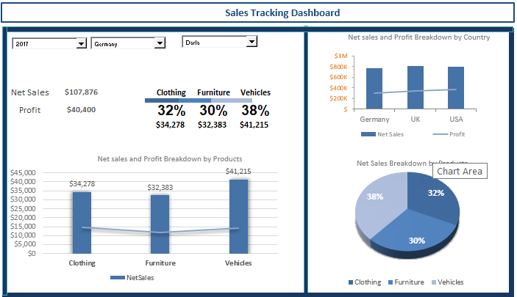
Revenue Insights: Sales & Profit Performance Dashboard

Slide 3
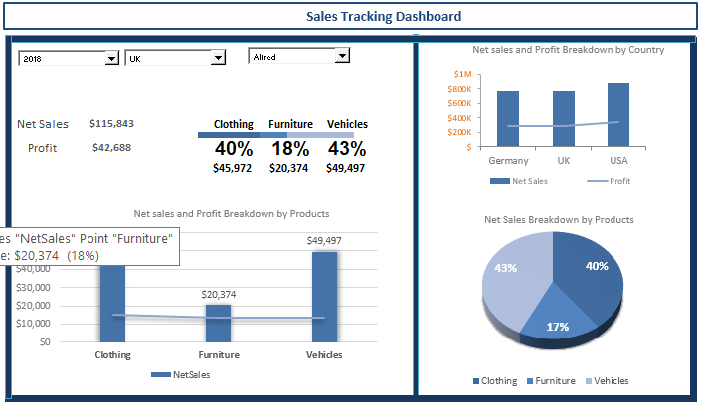
Revenue Insights: Sales & Profit Performance Dashboard

Slide 4
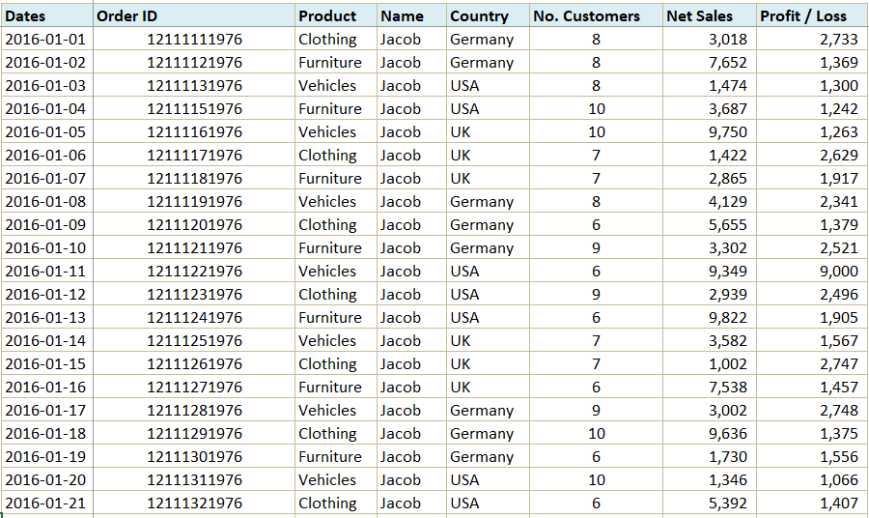
Revenue Insights: Sales & Profit Performance Dashboard
Walmart - Stores clean and raw data

Slide 5
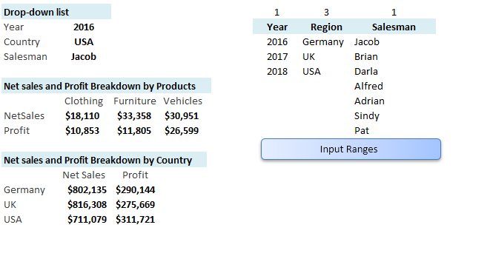
Revenue Insights: Sales & Profit Performance Dashboard
Calculation Notebook

